Slide 1
Talend Data Warehouse Creation overview
Md Moniruzzaman

Slide 2
Overview
There are two data Sources from single type,
Customer Information
Transaction

Slide 3
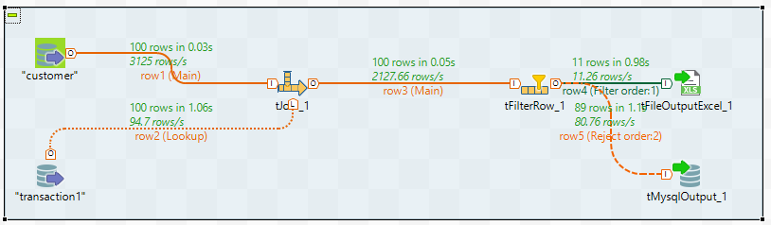
Talend – Schematics for Data Warehousing

Slide 4
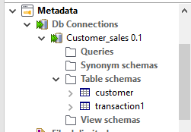
Data Import Methodology
Talend collects data from two different data sources which are in csv form.
For importing I have used single Metadata for db connection, and it connects two different sources initially.

Slide 5
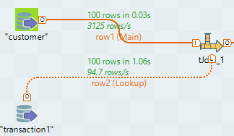
Table Joining

Slide 6
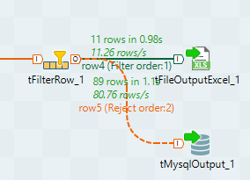
Filter Data
After joining tables it is filtered by using two separate rules, and shows the output to two different destination as per the required output.

Slide 7
Output
Output was based on requirements, and export it into one csv file and one MySQL database.
However, it can be used to send to some other type of databases for further investigation and Visualization.
The Main essence is we don’t need to repeat the same work again and again rather we can simply run the whole framework and get the output irrespective of the unknown raw data generates everyday.

Slide 8
Thank You

